Slide 1
Stress-strain-temperature relations
Chapter 5

Slide 3
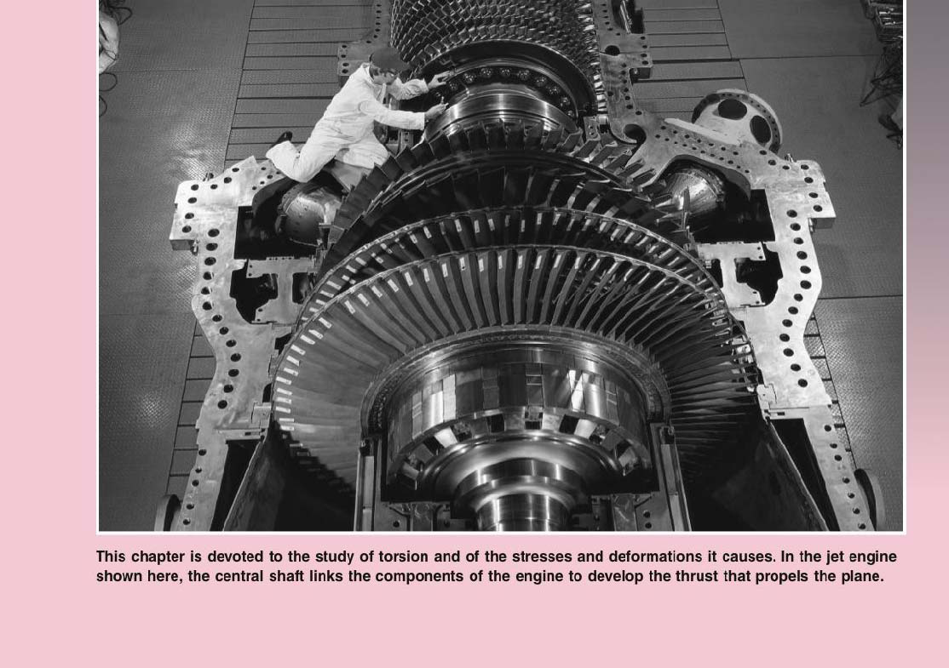
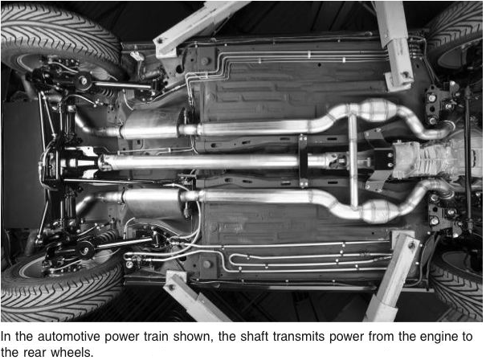
TORSION
Chapter 6
TORSION

Slide 4
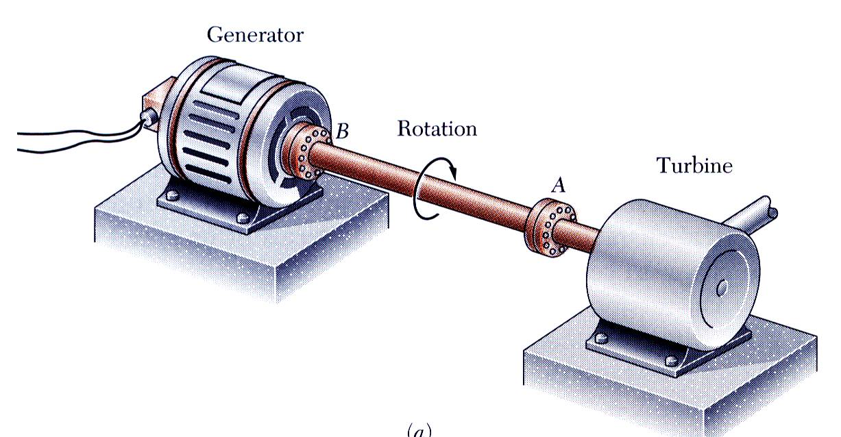
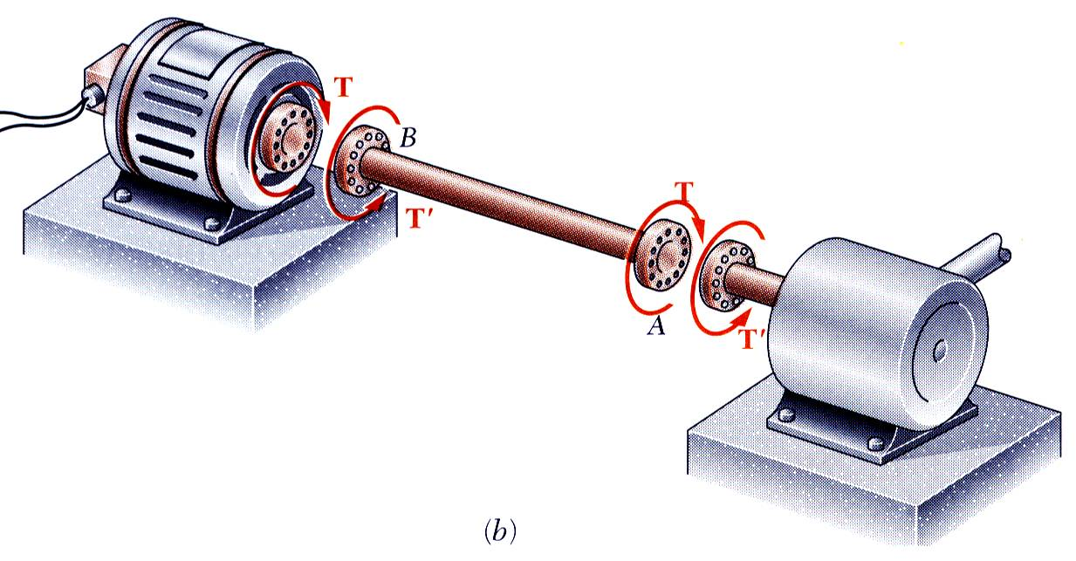
Torsional Loads on Circular Shafts
Interested in stresses and strains of circular shafts subjected to twisting couples or torques
Turbine exerts torque T on the shaft
Shaft transmits the torque to the generator
Generator creates an equal and opposite torque T’
In the transmission of power by a shaft in torsion, we are interested primarily in the twisting moment which can be transmitted by the shaft without damage to the material, and hence we wish to know what the stresses are in the shaft.

Slide 5
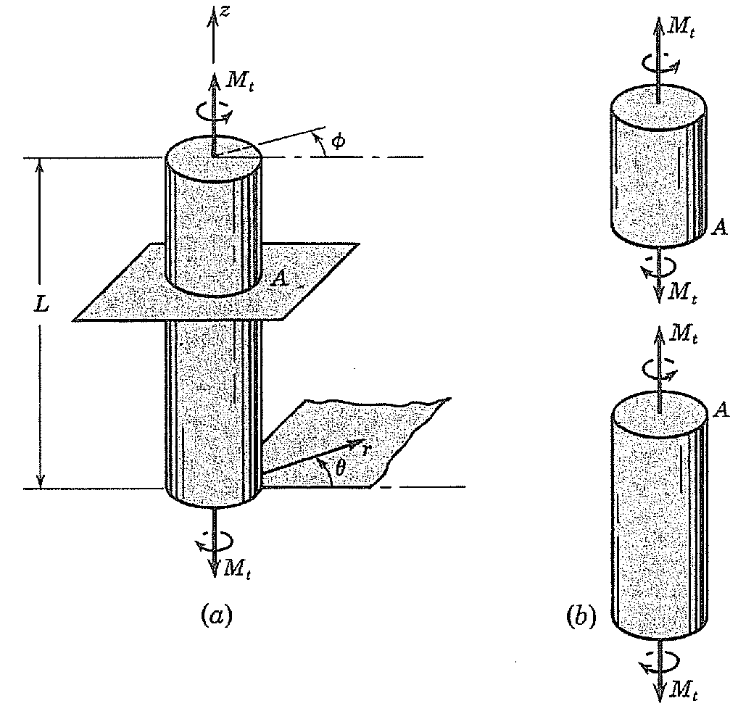
Geometry of deformation of a twisted circular shaft
Use of cylindrical coordinates r, Ɵ, z
Equilibrium requires that each cross section of the shaft must transmit the twisting moment M_{t} .

Slide 6
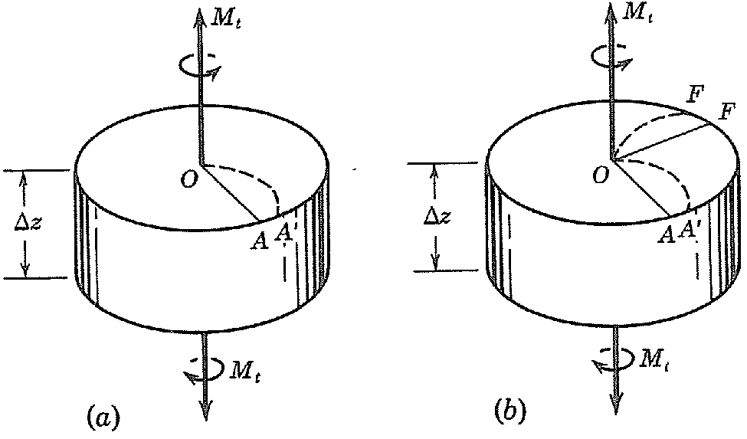
When a circular shaft is twisted, the cross sections must remain plane

Slide 7
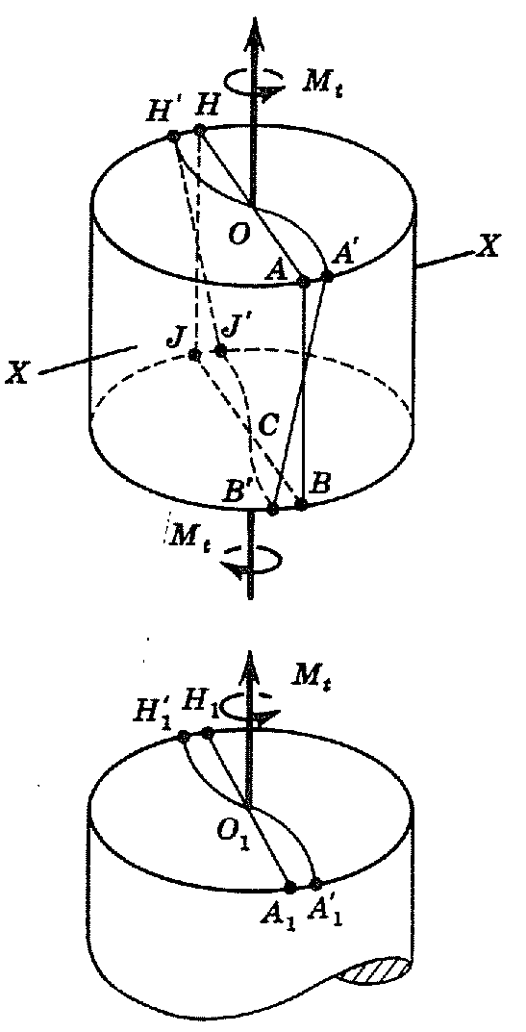
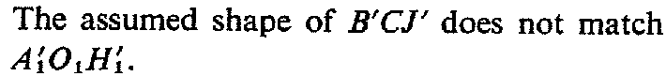

Slide 8
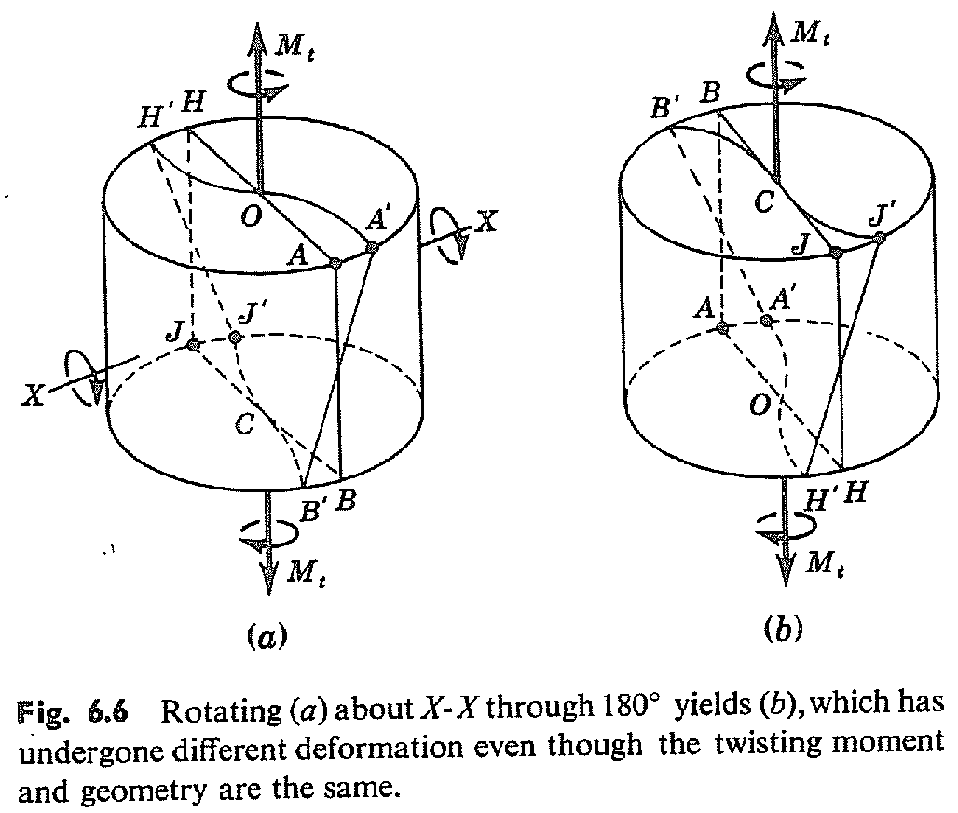

Slide 9
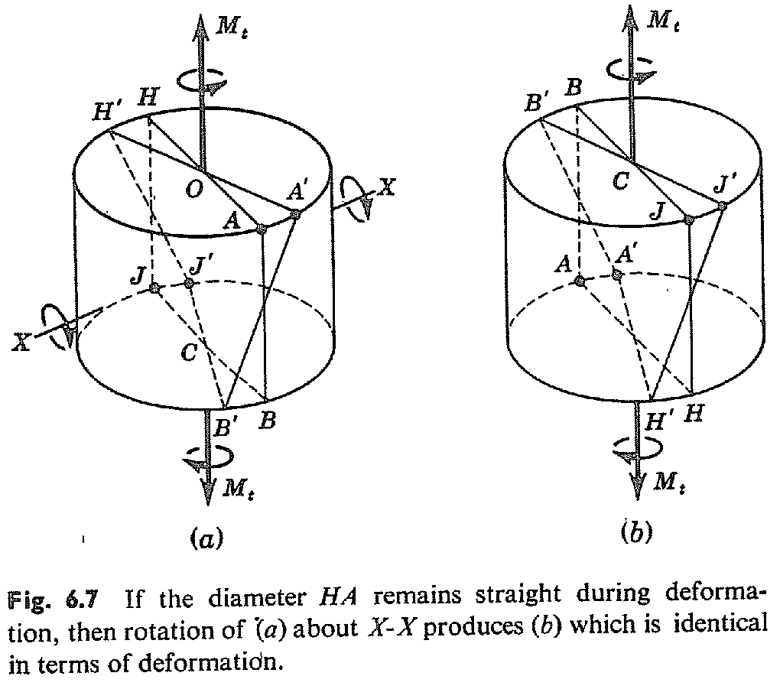
Each plane cross section originally normal to the axis remains plane and normal and does not distort within its own plane.

Slide 10
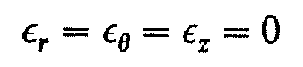
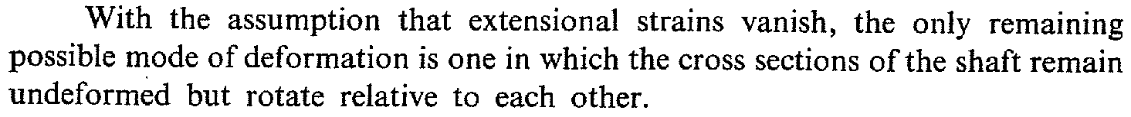
Dilational deformation

Slide 11
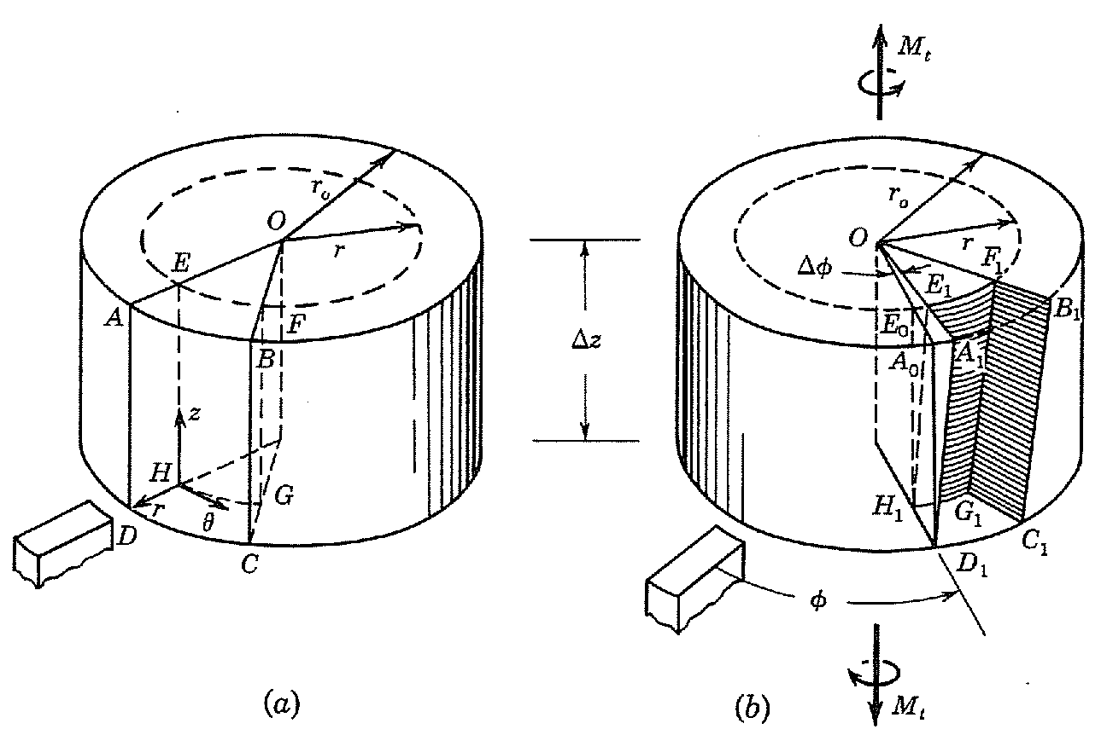
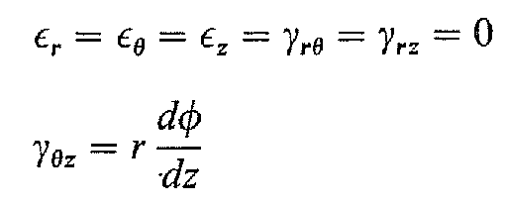

Slide 12
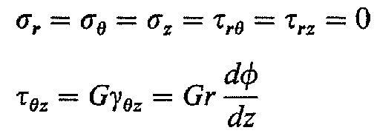
Stresses obtained from stress strain relations

Slide 13
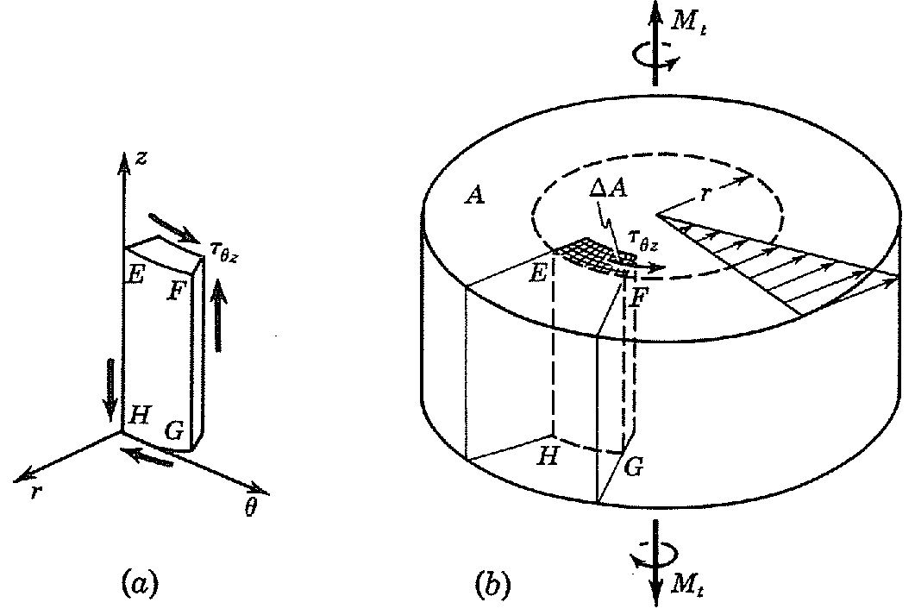
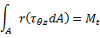
Equilibrium requirements

Slide 14
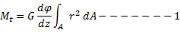
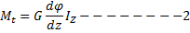
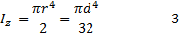
Stress and deformation in a twisted elastic circular shaft
From
------ (A)
and

Slide 15
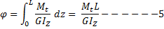
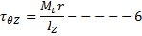
From Equation2
The total angle of twist between the ends is calculated by integrating eq 4
Substituting eq.4 in eq. A we get

Slide 16
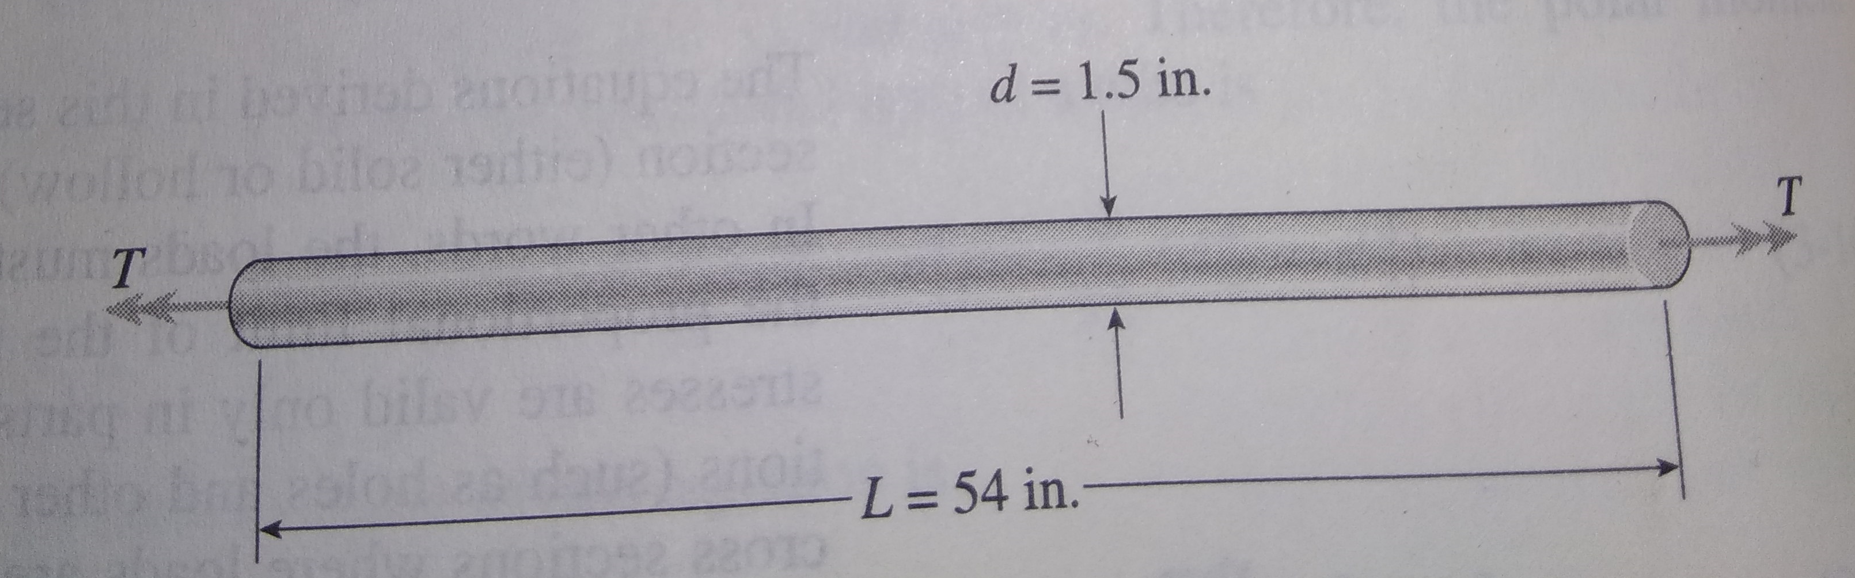
A solid steel bar of circular cross-section has diameter d=1.5in, length L=54in, and G=11.5x10⁶psi.
a) if T=250lb-ft, what is the max shear stress in the bar? What is the angle of twist between the ends.
b) if the allowable shear stress is 6000 psi and the allowable angle of twist is 2.5⁰, what is the maximum permissible torque?

Slide 17
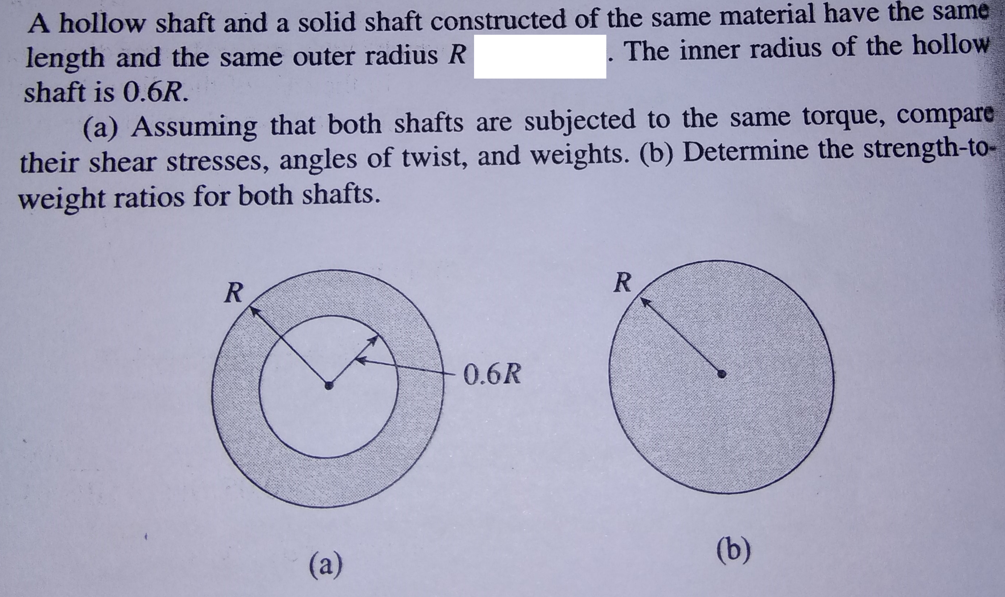

Slide 18
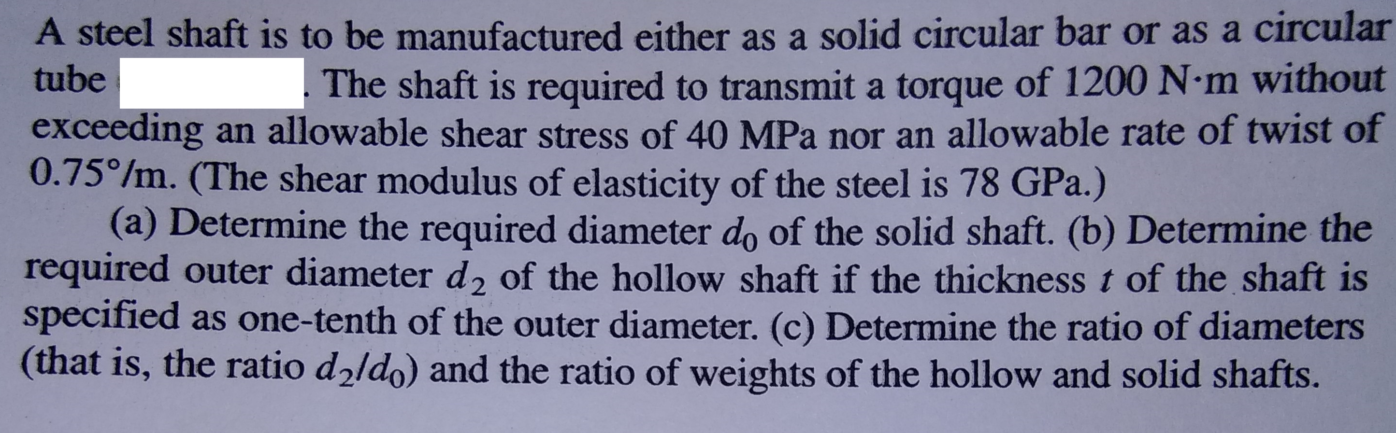
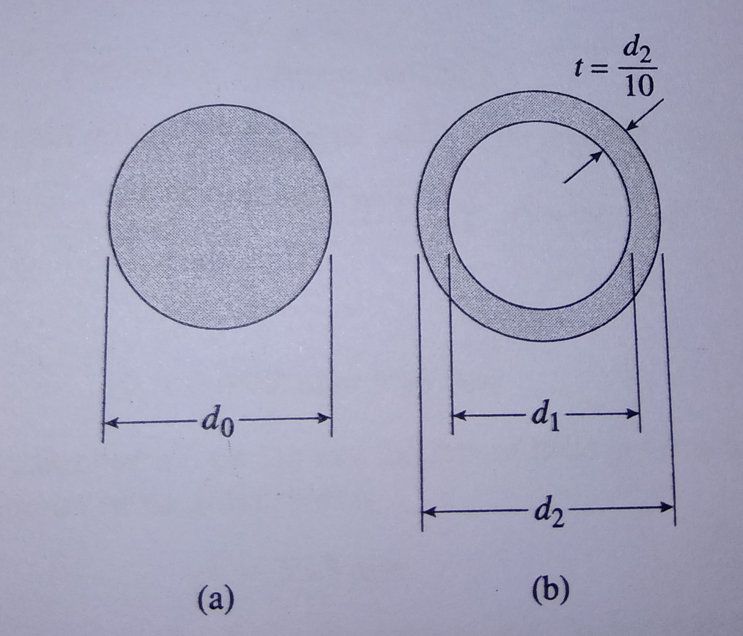

Slide 19
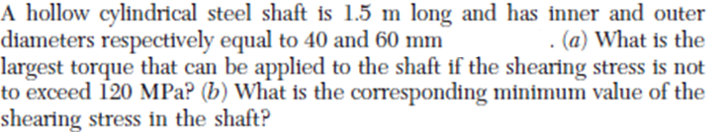
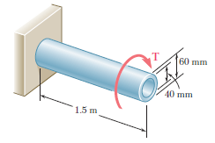
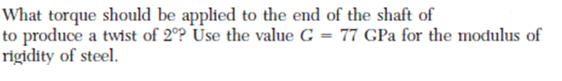

Slide 20
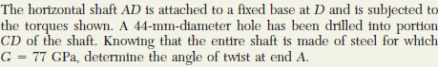
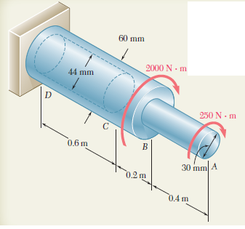

Slide 21
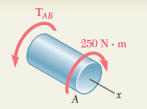
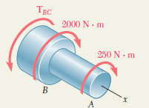
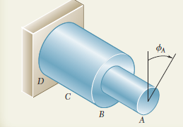
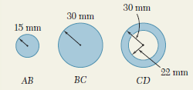

Slide 22
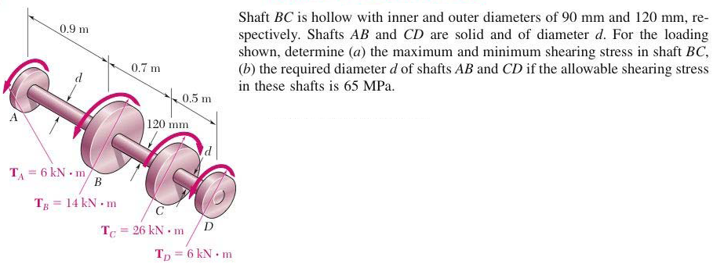
Problem

Slide 23
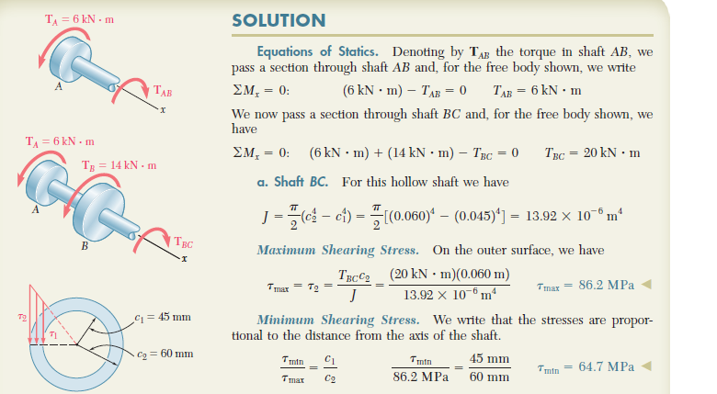

Slide 24
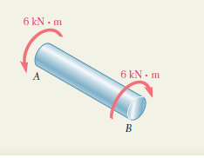
b
d = 77.8mm

Slide 25
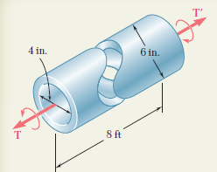
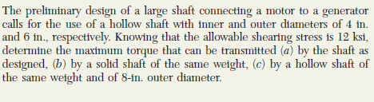
Problem

Slide 26
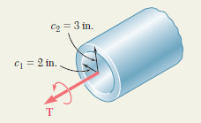
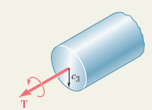
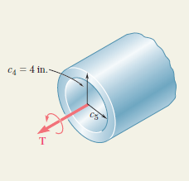

Slide 27
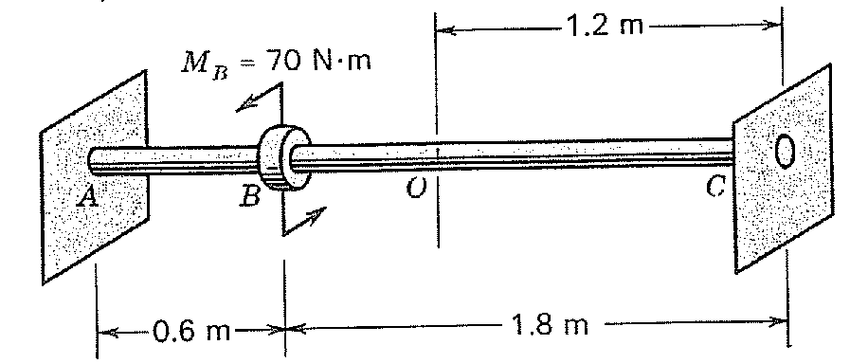
Dia = 25 mm; aluminum alloy shaft.
Find the angle through which O rotates.
G = 26.5 GN/m²

Slide 28
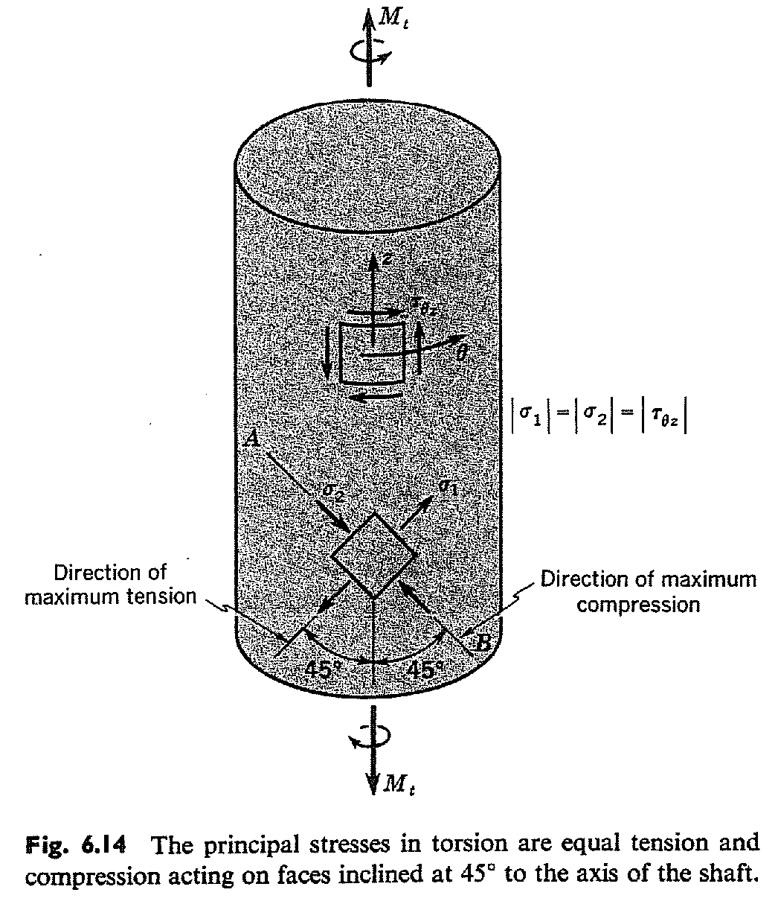
Stress analysis in torsion: Combined Stresses

Slide 29
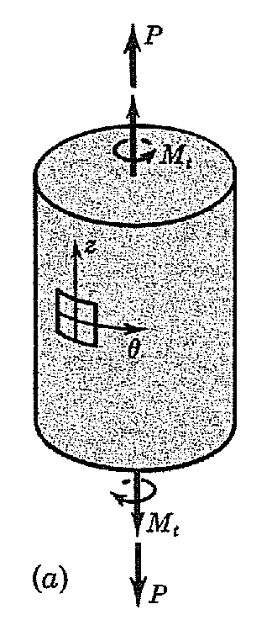
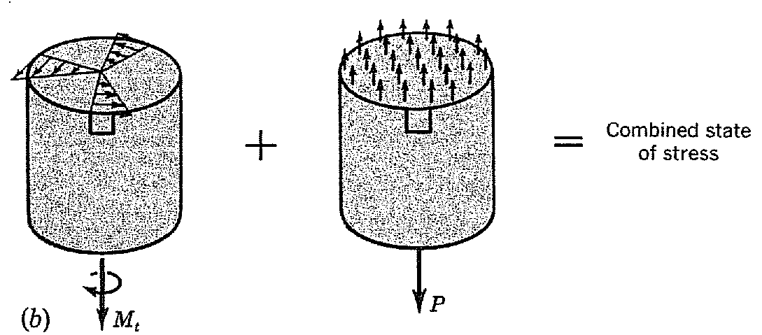
Stress analysis in torsion: Combined Stresses
A uniform, homogeneous circular shaft is subjected to an axial tensile force P and a twisting moment M_{t}.

Slide 30
Strain energy due to torsion
The onset of yielding in torsion
Mises yield criterion
Maximum shear-stress criterion

Slide 31
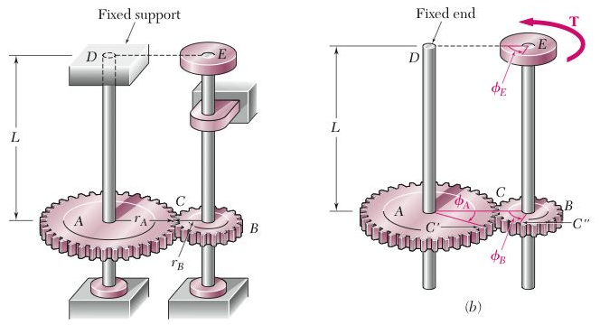
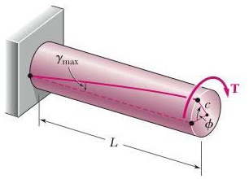
Angle of twist in the elastic range
Angle of twist is equal to the angle of rotation of the free end
Angle of twist is equal to the angle through which one end of the shaft rotates with respect to the other

Slide 32
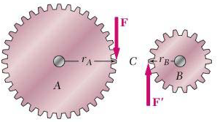
Find Φ_{E}

Slide 33


Problems
SOLUTION:
Apply a static equilibrium analysis on the two shafts to find a relationship between T_{CD} and T₀
Apply a kinematic analysis to relate the angular rotations of the gears
Find the maximum allowable torque on each shaft – choose the smallest
Find the corresponding angle of twist for each shaft and the net angular rotation of end A

Slide 34


SOLUTION:
Apply a static equilibrium analysis on the two shafts to find a relationship between T_{CD} and T₀
Apply a kinematic analysis to relate the angular rotations of the gears

Slide 35


Find the T₀ for the maximum allowable torque on each shaft – choose the smallest
Find the corresponding angle of twist for each shaft and the net angular rotation of end A

Slide 36
THANK YOU

